Slide 1



Himalaya Robotics Club
Arduino Training

Slide 2
Microcontrollers and Microprocessors
Microprocessor | Microcontroller
It is a CPU only, it needs to be paired with peripherals like RAM, ROM, and other to form a working system. | It is an integrated unit with CPU, memory (RAM and ROM), peripherals like ADCs, and communication interfaces like UART, I2C.
More complex, capable of running full fledged operating systems and multitasking. | Less complex, designed and optimized for specific tasks.
Consumes more power due to high performance and necessity to pair with other vital components. | Designed for low power consumption and suitable for battery-operated devices.
High processing power, clock speed in the range of hundreds of MHz to several GHz. | Limited processing power, using simple architectures, clock speed in the range of a few KHz to MHz.
General purpose, can be used for multiple tasks. | Used in embedded systems like appliances, Robotics and IoT.
Runs on full fledged OS. | Often runs without OS, or lightweight Real Time Operating System (RTOS).
For eg: Intel, AMD, Snapdragon processors | For eg: Arduino (ATmega328P), ESP32(Espressif), STM32 Development Boards

Slide 3
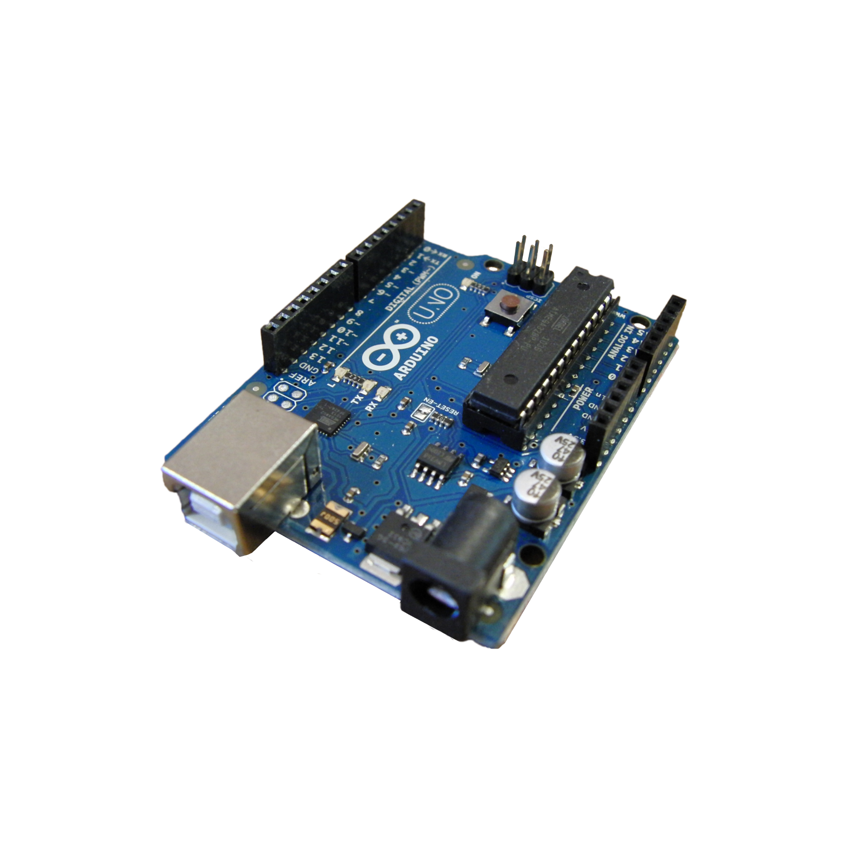
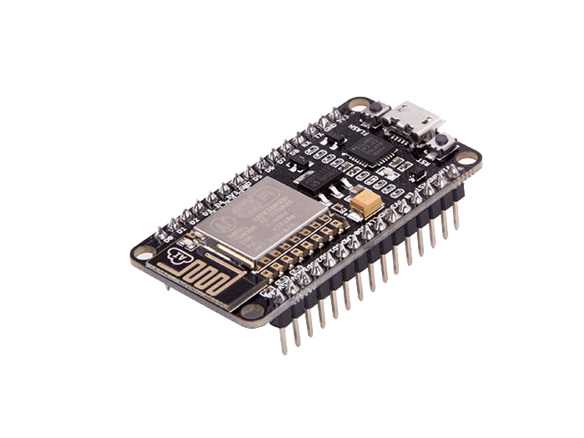
Examples of Microcontrollers (Development Boards)
Arduino Uno
ESP8266

Slide 4
Features of Arduino Uno
Uses ATmega328P microcontroller
14 digital pins (6 can be PWM outputs)
6 analog input pins
32 KB flash memory
2 KB SRAM
1 KB EEPROM
16 MHz clock speed
Powered and programmed via USB connection
Powered via USB, DC jack, or external power supply
Supports serial communication (TX/RX pins)
Built-in LED on pin 13
Includes a reset button
Open-source design and software
Compatible with Arduino IDE for programming

Slide 5
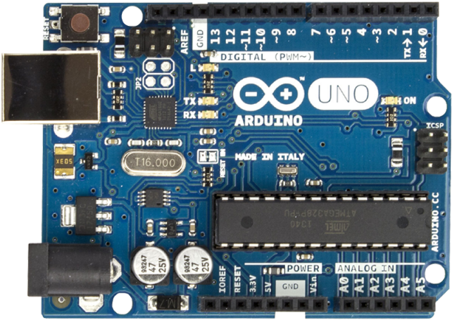

Slide 6
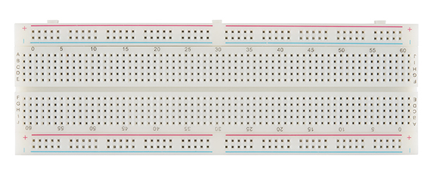
Breadboard

Slide 7
Blinking the Built In LED
pinMode(pin, mode)
Sets a pin as INPUT or OUTPUT
Example: pinMode(13, OUTPUT);
digitalWrite(pin, value)
Sends a HIGH (ON) or LOW (OFF) signal to a pin.
Example: digitalWrite(13, HIGH);
delay(milliseconds)
Pauses the program for a specified time in milliseconds.
Example: delay(1000); (waits 1 second)
delayMicroseconds(microseconds)
Pauses the program for a specified time in microseconds (1/1,000,000 of a second).
Example: delayMicroseconds(1000); (waits 1 millisecond)

Slide 8
Program
void setup() {
pinMode(13, OUTPUT);
}
void loop() {
digitalWrite(13, HIGH);
delay(1000);
digitalWrite(13, LOW);
delay(1000);
}

Slide 9
Blinking an External LED
Just use the Pin Number with which the External LED is connected through a resistor and then the rest of the code remains the same
Program
void setup() {
pinMode(13, OUTPUT);
}
void loop() {
digitalWrite(13, HIGH);
delay(1000);
digitalWrite(13, LOW);
delay(1000);
}

Slide 10
Pulse Width Modulation (PWM)
Pulse: A digital signal that switches between HIGH (on) and LOW (off).
Pulse Width: The amount of time the signal remains HIGH in one cycle.
Duty Cycle: The percentage of time the signal is HIGH within a cycle. A higher duty cycle means the pulse is on for a longer time, and a lower duty cycle means it is on for a shorter time.
Pulse Width Modulation (PWM) is a technique used in electronics to simulate an analog output by rapidly switching a digital signal on and off. The duration for which the signal stays on (called the duty cycle) controls the average power(voltage) delivered to a load, which is used for various applications such as controlling the brightness of an LED, speed of motors and so on.
For example:
A 100% duty cycle means the signal is always HIGH (on) — effectively delivering continuous power.
A 50% duty cycle means the signal is HIGH for half the time and LOW for the other half — delivering average power over time.
A 0% duty cycle means the signal is always LOW (off) — no power is delivered.
The GPIO Pins which support PWM in Arduino have a tilde (~) symbol

Slide 11
PWM Function
analogWrite(pin, value)
The analogWrite() function in Arduino uses 8-bit resolution, meaning the value you provide can range from 0 to 255. This gives you 256 distinct levels to control the output signal.
pin: This is the Arduino pin number where the PWM signal will be output. Examples include 9, 10, etc.
value: This is a number between 0 and 255 that determines the duty cycle of the PWM signal.
A value of 0 means the signal is always off (0% duty cycle).
A value of 255 means the signal is always on (100% duty cycle).
Any value in between adjusts how long the signal stays HIGH during each cycle, thus controlling the perceived brightness of an LED or speed of a motor.
This 8-bit resolution allows for smooth control of devices with a digital output that mimics analog behavior.

Slide 12
Controlling the Brightness of an LED with PWM
Connect the LED to any of the GPIO pins that supports PWM through a resistor. Connect the other end to the ground.
Program
int ledPin = 3;
void setup() {
pinMode(ledPin, OUTPUT);
}
void loop() {
analogWrite(ledPin, 0);//0% Duty Cycle
delay(1000);
analogWrite(ledPin, 128);//Close to 50% Duty Cycle
delay(1000);
analogWrite(ledPin, 255);//100% Duty Cycle
delay(1000);
}

Slide 13
Serial Monitor
The Serial Monitor is a built-in feature in the Arduino IDE that allows you to send and receive data between your Arduino board and the computer. It's a useful tool for debugging, viewing output from your program, or sending data to the Arduino for control.
When you use the Serial Monitor, your Arduino can print text or variables for display, or you can send commands to the board from the computer.
Some commonly used methods of Serial Monitor are as below:
Serial.begin(speed)
Initializes serial communication at a specified baud rate (speed).
Example: Serial.begin(9600); (9600 baud is commonly used; baud rates like 115200, 19200, etc are also available).
This command has to be used at the void setup(){} part.
Baud rate = Number of symbols transmitted per second.
Bit rate = Number of bits transmitted per second
For example: If a system uses 4 bits per symbol (for example, in quadrature amplitude modulation (QAM)), and the baud rate is 9600, the bit rate would be 9600 * 4 = 38400 bps (or 38.4 kbps).

Slide 14
Serial.print(value)
Sends data (text, numbers, etc.) to the Serial Monitor without a newline.
Example: Serial.print("Hello"); (prints Hello without a line break).
Serial.println(value)
Sends data followed by a newline character, moving to the next line.
Example: Serial.println("Hello"); (prints Hello and moves to a new line).
Serial.available()
Returns the number of bytes available to read from the Serial buffer (0 if nothing is present to be read).
Example: if (Serial.available() > 0) (checks if data is available to be read).
Serial.readStringUntil()
The Serial.readStringUntil() method in Arduino is used to read a sequence of characters from the serial buffer until a specified termination character is obtained. It returns the received data as a String object.

Slide 15
Serial.parseInt()
Reads the next integer from the Serial buffer. Stops reading when a non-numeric character or timeout is encountered
Example: int value = Serial.parseInt(); (reads an integer).
Serial.parseFloat()
Reads the next floating-point number from the Serial buffer. Stops reading when a non-numeric character or timeout is encountered.
Example: float value = Serial.parseFloat(); (reads a float).
Serial.readString()
The Serial.readString() method in Arduino is used to read a sequence of characters from the serial buffer until a newline character (\n) or a timeout occurs. It returns the received data as a String object.

Slide 16
Write an upgraded version of the previous PWM Led Code that asks the user for an integer input (say 0, 1, 2, 3, 4) and set the brightness of the LED accordingly by assuming suitable steps.

Slide 17
Design a 4 bit binary counter using 4 LEDs (1 second wait time between each state)

Slide 18
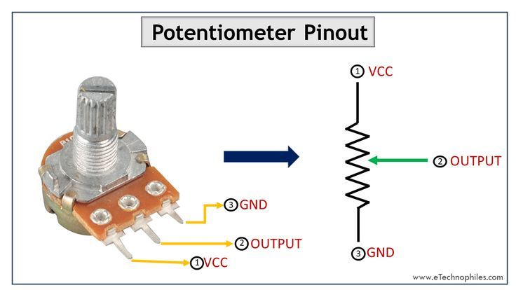
Potentiometer

Slide 19
Potentiometer Overview: A potentiometer is a variable resistor with three terminals. It allows you to control the flow of electrical current by adjusting its resistance, typically used to adjust voltage in a circuit.
How It Works: It has two fixed terminals connected to the ends of a resistive track, and a movable wiper that slides along this track. Moving the wiper changes the resistance between the wiper and the terminals, altering the voltage or current.
Linear Potentiometer: In a linear potentiometer, the resistance changes in a straight line as the wiper moves from one end to the other. This means the output voltage is directly proportional to the wiper position.
Rotary Potentiometer: A rotary potentiometer works by rotating a knob, which moves the wiper along the resistive track. This type of potentiometer is commonly used for volume controls, brightness adjustments, and tuning dials.
Applications: lights (for brightness adjustment), and in various sensors for controlling systems like motors or robots.
Adjusting Voltage: Potentiometers can provide a variable output voltage based on their position, making them ideal for fine-tuning electronic devices.

Slide 20
Analog to Digital Converter (ADC)
The ADC (Analog-to-Digital Converter) in Arduino allows the board to read analog signals from sensors and convert them into digital values that the microcontroller can process.
In the Arduino Uno, there are 6 analog pins (labeled A0 to A5). These pins can read voltages from 0V to 5V (or 0V to 3.3V on some boards) and convert them into a digital value between 0 and 1023, using a 10-bit resolution.
For example, if you connect a sensor to pin A0, the Arduino will read the voltage at that pin and return a digital value between 0 and 1023, based on the input voltage. The higher the resolution, the more precise the measurement, and with 10 bits, Arduino can achieve a good balance of accuracy for most general applications.
analogRead(pin)
The analogRead() function in Arduino is used to read the voltage from an analog pin (like A0 to A5) and convert it into a digital value that the Arduino can understand.
It returns a number between 0 and 1023, where:
0 means 0V 1023 means the maximum voltage (5V).

Slide 21
Create a LED Dimmer using Potentiometer

Slide 22
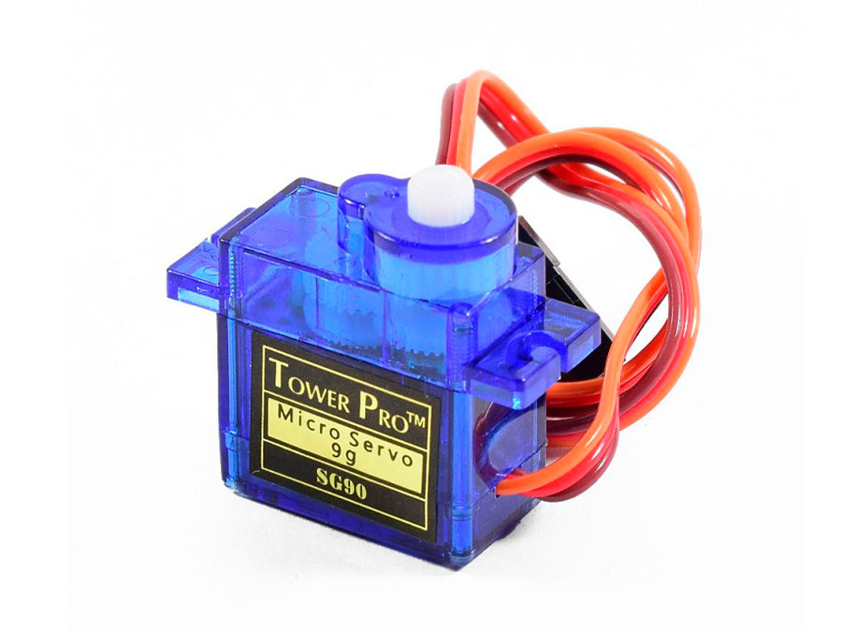
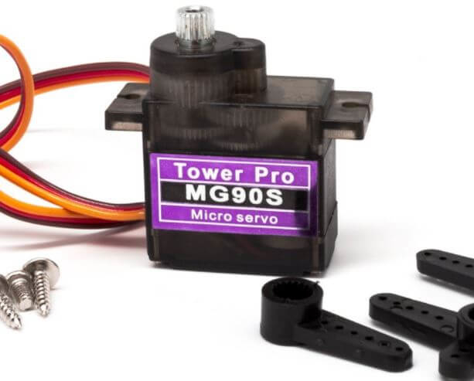
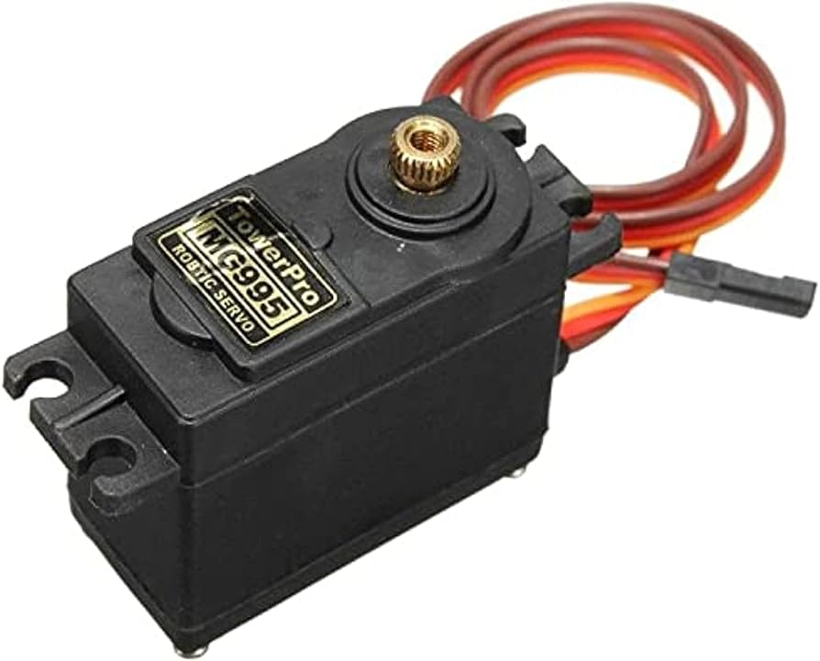
Servo Motor
A servo motor is a type of motor that can rotate to a specific angle, rather than just spinning continuously. It’s commonly used in robotics and other projects where precise movement is needed, such as turning a robotic arm, controlling the position of a camera, or moving a wheel.
A servo motor has a control wire that tells it the exact angle to rotate.
It can rotate anywhere from 0° to 180° (in most cases), and you can control the position by sending the motor a specific signal.
Red Wire- Vcc, Brown Wire- GND, Yellow Wire- Control Wire

Slide 23
Interfacing Servo Motor with Arduino
#include <Servo.h> // Include the Servo library
Servo myServo; // Create a Servo object
void setup() {
myServo.attach(9); // Attach the servo to pin 9
}
void loop() {
myServo.write(0); // Move the servo to 90 degrees
delay(1000); // Wait for 1 second
myServo.write(90); // Move the servo to 0 degrees
delay(1000); // Wait for 1 second
myServo.write(180); // Move the servo to 0 degrees
delay(1000); // Wait for 1 second
}

Slide 24
Control Servos using Potentiometer

Slide 25
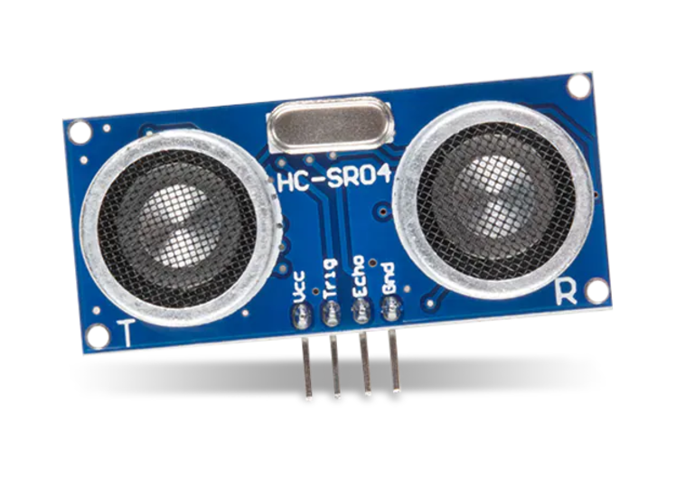
Ultrasonic Sensor (HC-SR04)
An ultrasonic sensor is a device that measures distance by using sound waves. It sends out a high-frequency sound pulse and then measures the time it takes for the sound to bounce back after hitting an object. By knowing the speed of sound and the time taken for the sound to return, the sensor can calculate the distance to the object.
Ultrasonic Sensor Working with Trigger and Echo:
The Trigger pin on the ultrasonic sensor needs to be set HIGH for at least 10 microseconds. This is like telling the sensor to send out a burst of ultrasonic waves.
After sending the sound waves, the sensor waits for them to bounce back.
The Echo pin goes HIGH when the sound is sent and stays HIGH until the sound wave is received back.
The time the Echo pin remains HIGH represents the total time taken by the sound to travel to the object and back.
using pulseIn(EchoPin, HIGH):
The pulseIn() function in Arduino is used to measure how long a pin (in this case, the Echo pin) stays HIGH.
The speed of sound in air is approximately 343 meters/second (or 0.0344 cm/microsecond).
​distance = (duration/2)*0.032(approx.)

Slide 26
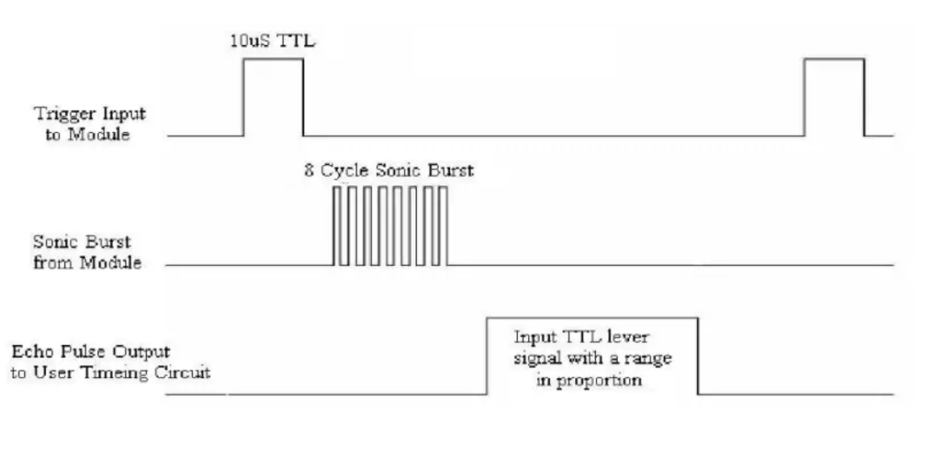

Slide 27
Interface Ultrasonic Sensor with Arduino

Slide 28
Buzzer Security System with Ultrasonic Sensor

Slide 29
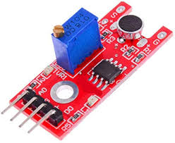
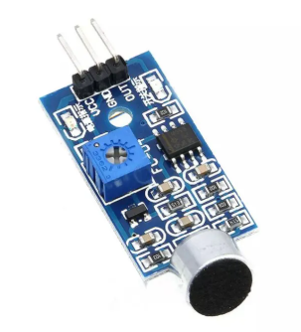
Microphone Sound Sensor
It is a sound detection sensor that responds to sound intensity. It is commonly used in Arduino projects for detecting claps, whistles, or other sharp sounds.
Key Features:
Microphone: Detects sound vibrations from the environment.
Potentiometer: Adjusts the sensitivity of the sound detection.
Outputs:
Digital Output (D0): Goes HIGH when the sound exceeds the set threshold.
Analog Output (A0): Provides a variable voltage representing the sound intensity.

Slide 30
Clap Switch

Slide 31
Some Beginner Project Ideas
Obstacle Avoiding Car
Line Following Robot
Bluetooth-Controlled Car
Robotic Arm with Servo Motors
Pick-and-Place Robotic Arm
Smart Dustbin (lid opens automatically using ultrasonic sensors)
Home Automation via Mobile App
Fire Fighting Robot (uses flame sensors and a water pump)

